Slide 1

Designing a Tech Program PPT Template for Dense Information
This presentation outlines strategies and practical tips for creating effective PowerPoint templates for technology programs, focusing on how to manage and present a large volume of complex information clearly and engagingly.

Slide 2
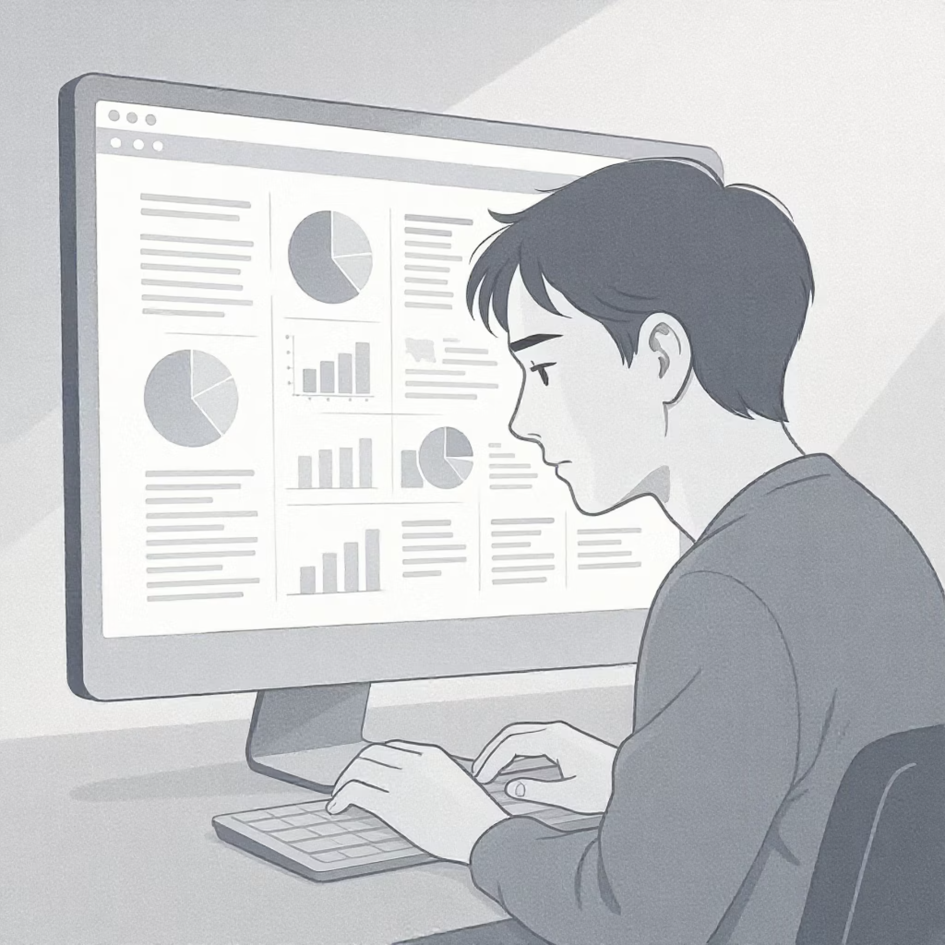

Challenge: Presenting Lots of Tech Info in Few Slides
Tech programs, by their nature, involve intricate details, extensive data, and often, highly technical concepts. Communicating this complexity effectively within the confines of a presentation can be a significant hurdle. The challenge isn't just about fitting everything onto the slides; it's about ensuring the information is digestible and memorable for the audience.
Detailed Data: From performance metrics to user statistics, tech programs generate vast amounts of data that often need to be visualized or summarized.
Timelines & Roadmaps: Project phases, development sprints, and future plans require clear, sequential representation.
Visuals & Diagrams: System architectures, process flows, and technical schematics are crucial but can quickly overcrowd a slide.
Risk: Overcrowded Slides Reduce Clarity and Audience Retention
When slides are too dense, they become visually noisy and cognitively taxing. Audiences struggle to identify key messages, leading to reduced comprehension and disengagement. The goal is to inform, not overwhelm.

Slide 3



Key Strategy: Visual Hierarchy & Modular Layouts
Clarity through Hierarchy
1
Guide the viewer's eye with clear visual cues.
Modular Information Blocks
2
Break down content into manageable, self-contained units.
Strategic White Space
3
Allow elements to breathe, improving readability.
Establishing a strong visual hierarchy is paramount when dealing with dense information. This means using varying font sizes, weights, and colors to differentiate between primary information (headings, key takeaways) and secondary details (subheadings, body text, supporting data). Think of your slide as a newspaper article – the headlines draw you in, and subheadings provide quick context, while the body text fills in the details.
Modular layouts involve dividing your slide into distinct sections, each dedicated to a specific piece of information. This could be achieved through columns, distinct background colors for sections, or clearly defined boxes. By segmenting content, you prevent information overload and allow the audience to focus on one module at a time.
Clear Headings & Subheadings: Act as signposts, guiding the audience through the content and allowing for quick scanning.
Bullet Points & Lists: Break down complex sentences into digestible chunks, making information easier to absorb.
Strategic Use of Icons: Replace lengthy descriptions with universally understood symbols to convey meaning quickly.

Slide 4
Slide Design Techniques for High-Information Density
Multi-Column Layouts
Infographics & Icons
Layered Content
Divide your slide into 2-3 vertical columns to present related but distinct pieces of information side-by-side. This is ideal for comparisons, pros/cons, or breaking down a single concept into components. Ensure each column maintains its own internal hierarchy.
Visualize data and concepts instead of just stating them. Use charts (bar, pie, line) for quantitative data, and process flow diagrams for sequences. Icons can effectively convey ideas, features, or categories without requiring much text. For example, a "gear" icon for settings or a "magnifying glass" for analysis.
For digital presentations, consider using features that allow content to be revealed progressively. This could be through simple animations that fade in text blocks, or more advanced interactive elements that reveal deeper details upon a click or hover. This technique prevents immediate cognitive overload by presenting information in stages.
When designing for high-information density, it's crucial to employ techniques that maximize clarity without sacrificing detail. The goal is to present complex information in a way that is both comprehensive and easy to navigate.

Slide 5



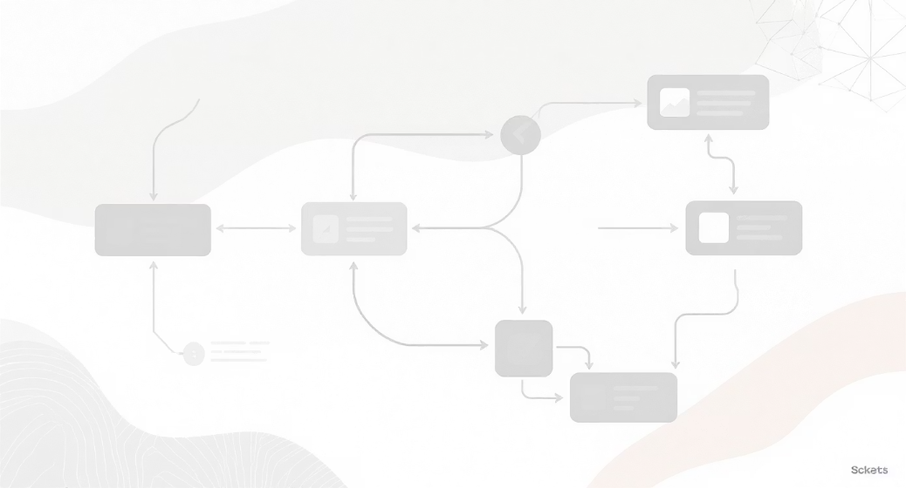
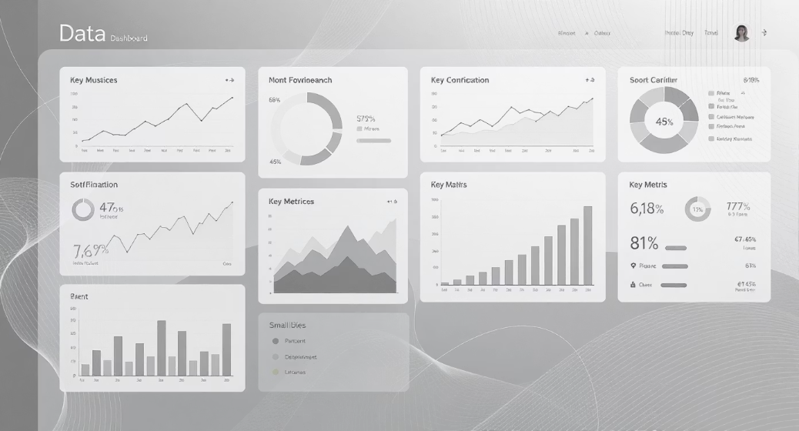
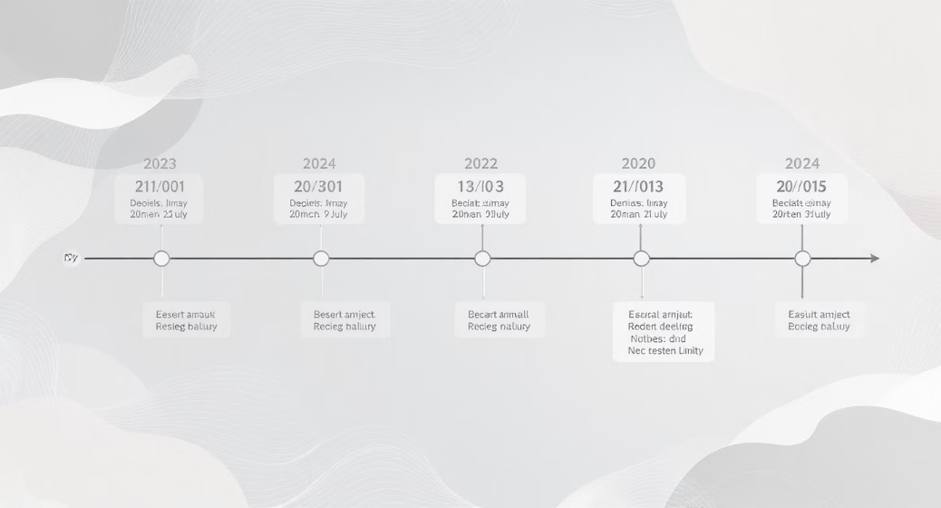
Example Slide Types to Accommodate Dense Content
Process Flows
Data Dashboards
Illustrate sequential steps in a process, system, or workflow. Use clear directional arrows, numbered steps, and concise descriptions for each stage. Flowcharts or swimlane diagrams are effective. Ensure consistency in shapes and colors for different types of steps or decisions.
Timeline & Milestones
Consolidate key performance indicators (KPIs) and metrics using a combination of charts (line, bar, pie) and numerical callouts. Highlight critical figures with larger fonts or distinct colors. Focus on 3-5 primary metrics per slide to avoid clutter, using accompanying text for context.
Visually represent project phases, key deliverables, and historical achievements. Use a horizontal or vertical timeline, marking milestones with distinct icons or brief text labels. Each milestone can link to a more detailed appendix slide if needed.
These example slide types are specifically designed to present detailed information efficiently. By leveraging visual structures, you can convey complex data, project plans, and operational sequences in a clear and compelling manner.

Slide 6



Leveraging Technology-Themed Templates
Many online platforms offer a wealth of professionally designed PowerPoint templates tailored for technology-related presentations. These templates often come equipped with pre-built slide layouts, relevant icons, and data visualization tools, significantly reducing design time and ensuring a polished, consistent look.
Slidesgo: Known for its extensive collection of creative and modern templates across various themes, including numerous options for tech, data, and business presentations. They often include integrated infographic elements.
Canva: A user-friendly design platform with a vast library of customizable templates. Canva allows for easy drag-and-drop editing, making it accessible even for those without extensive design experience. Its templates often feature strong visual elements and can be adapted for dense information.
SlidesCarnival: Offers free, professional templates compatible with PowerPoint and Google Slides. Their tech-focused templates are clean, well-structured, and provide excellent starting points for organizing complex content.
These resources provide more than just aesthetic themes; they offer practical frameworks for organizing information. Many include pre-designed infographic sets (e.g., timelines, process flows, data charts) that are optimized for clarity and visual appeal, saving you from creating these elements from scratch.

Slide 7
Best Practices for Readability & Engagement
Limit Text per Slide
Consistent Color Coding
Judicious Use of Animations
Even when presenting dense information, strive for conciseness. Use keywords, short phrases, and bullet points rather than full sentences or paragraphs. The goal is to provide enough information to convey the message without overwhelming the viewer. Remember, the presentation is a visual aid, not a script.
Implement a consistent color scheme to group related information or highlight key data points. For example, use blue for "features," light gray for "background," and darker gray for "challenges." This creates visual anchors and helps the audience quickly identify different categories of information.
Animations can be powerful tools for revealing information progressively, reducing clutter, and maintaining audience focus. However, use them sparingly and purposefully. Avoid overly complex or distracting animations. Simple fades, wipes, or fly-ins that reveal one bullet point or section at a time are most effective for managing information flow.
Beyond choosing the right layout, adhering to best practices in visual design significantly enhances readability and keeps the audience engaged, even when dealing with a high volume of information. These principles ensure that your presentation is not just informative, but also aesthetically pleasing and easy to follow.

Slide 8
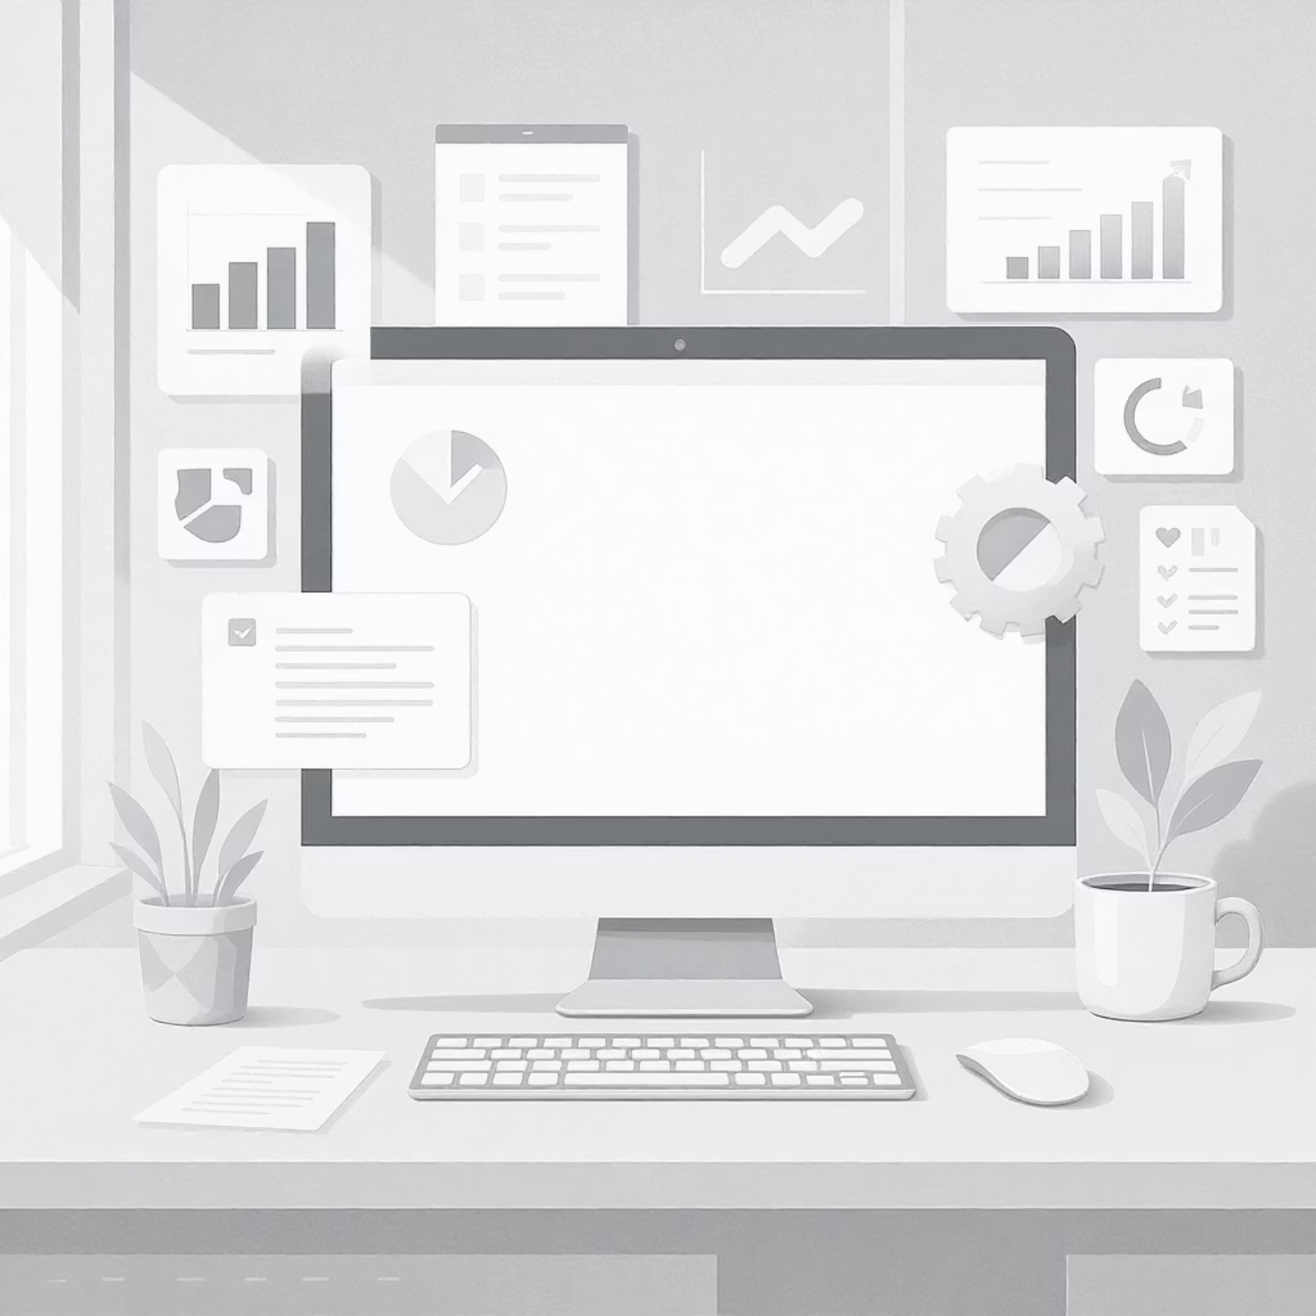
Tools & Features to Enhance Your Tech PPT Template
Modern presentation software and design tools offer advanced features that can elevate your tech program template, making it more dynamic, interactive, and efficient to create and update.
Drag-and-Drop Editors: Platforms like Canva, Beautiful.ai, and even advanced PowerPoint versions offer intuitive drag-and-drop interfaces that simplify the process of arranging elements. This allows for quick customization and experimentation with different layouts.
Integration of Charts, Icons, & Multimedia: Leverage built-in chart generators, extensive icon libraries, and seamless multimedia embedding capabilities. Instead of static images, consider embedding short video clips or interactive diagrams where appropriate.
Collaboration Features: For team-based projects, tools that support real-time collaboration (e.g., Google Slides, Microsoft 365 PowerPoint) are invaluable. They allow multiple team members to contribute, review, and update the template simultaneously, ensuring consistency and accuracy across all slides.
Master Slide Customization: Utilize the master slide view in PowerPoint or Keynote to set default fonts, colors, and layouts. This ensures consistency across your entire presentation and makes it easy to apply changes globally.
By utilizing these tools and features, you can streamline the creation process, enhance the visual appeal, and improve the overall effectiveness of your tech program presentation template.

Slide 9
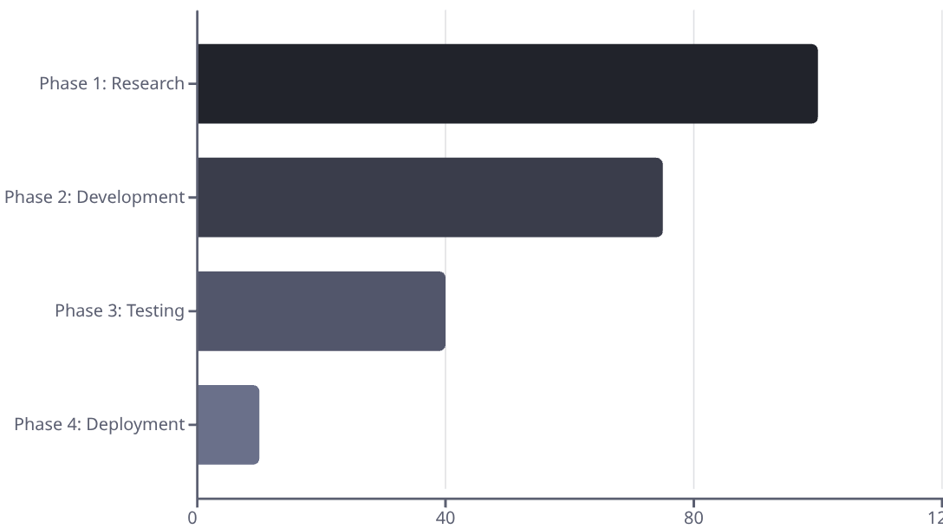
Case Study: Effective Tech Program Slide
Program Overview
Key Features
Timeline & Milestones
This section provides a high-level summary of the program's purpose, scope, and target audience. It uses concise bullet points to highlight the core mission and strategic objectives, setting the context for the detailed information to follow.
Here, each primary feature of the tech program is presented with a clear icon and a brief, descriptive phrase. This visual-text pairing allows for quick comprehension of functionalities without overwhelming the viewer with technical jargon.
A clean, horizontal timeline visualizes key project phases and their completion dates. Milestone markers (small circles) are used instead of lengthy text, reinforcing the progress visually. This provides a clear roadmap at a glance.
Project Alpha: AI-driven analytics platform
Data Ingestion: Scalable, secure data pipeline.
Enhance data processing by 30%
Predictive Analytics: Real-time forecasting models.
Target: Enterprise clients
Robust Security: End-to-end data encryption.
This example demonstrates how a well-structured slide can convey a significant amount of information by using a combination of multi-column layouts, visual icons, and concise text. The branded color scheme and clear fonts contribute to readability and a professional appearance.

Slide 10

Conclusion: Build Your Tech PPT Template to Inform & Inspire
"The aim of argument, or of discussion, should not be victory, but progress."
— Joseph Joubert
Designing an effective tech program presentation template is about more than just aesthetics; it's about optimizing communication for clarity, engagement, and impact. By applying thoughtful design principles, you transform dense technical information into an accessible and compelling narrative.
1
Prioritize Clarity Through Smart Layout & Visuals
2
Use Professional Tech Templates as a Foundation
3
Customize to Your Program’s Unique Data & Storytelling Needs
Focus on visual hierarchy, modular sections, and the strategic use of icons and infographics. These elements break down complexity and guide your audience's understanding.
Leverage existing high-quality templates from reputable sources. They provide a strong starting point and often include features tailored for technical content, saving valuable design time.
Adapt the template to reflect your specific data, branding, and narrative. Personalization ensures the presentation resonates deeply with your audience and effectively conveys your program’s essence.
Result: Engaged Audience, Clear Communication, Impactful Presentation
A well-designed template ensures your technical insights are not only understood but also remembered, driving decision-making and fostering support for your tech initiatives.

